Slide 1
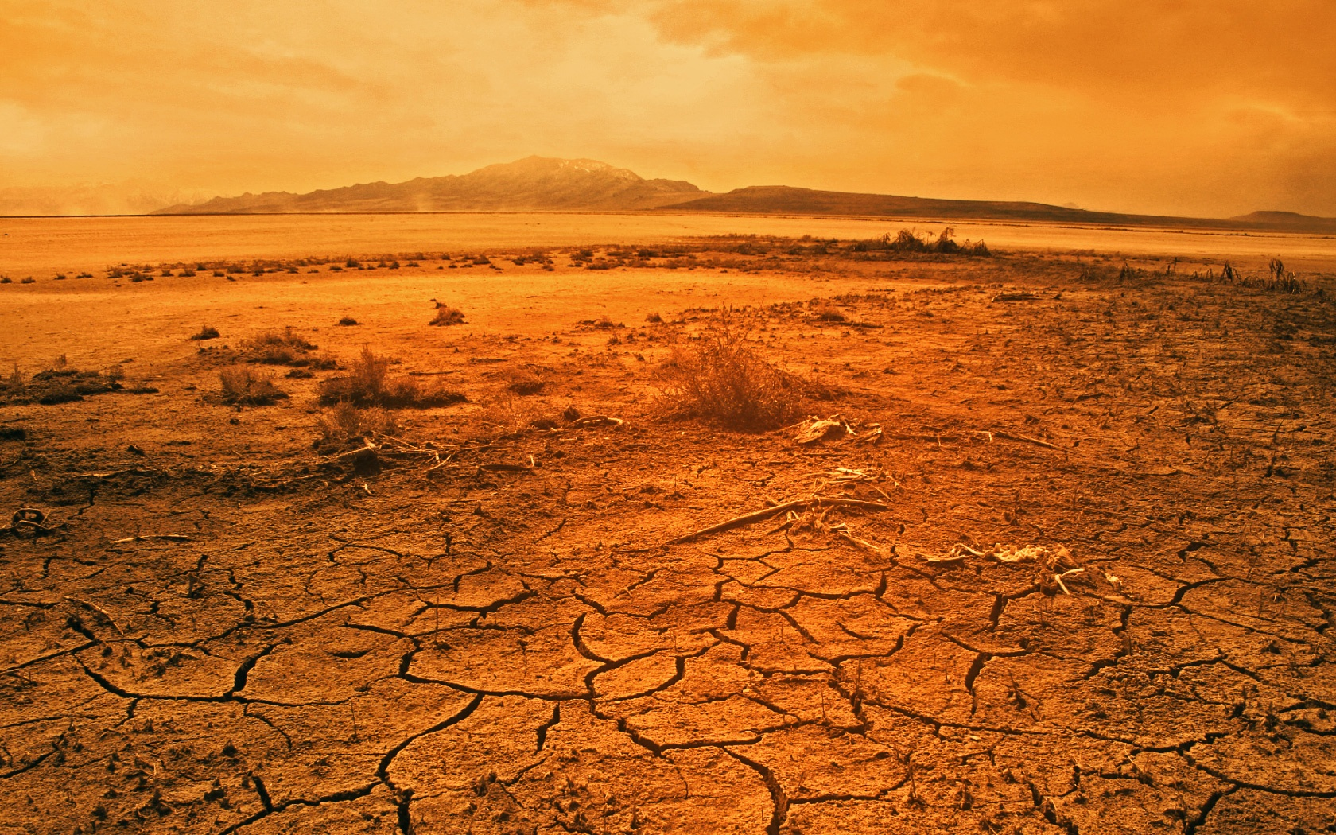
www.iwallscreen.com/stock/desert-wallpapers-hd.jpg
Notes:
Some of the imaged provoked by when we think of the word desert are “dry”, “desolate”, “cactus”, and “camels”. Even if those images are not the first to come to your mind the ones that do are seldom pleasant. We see Deserts as places where whether conditions so harsh, few plants can even grow. But would the word desert invoke a image of a major city?

Slide 2
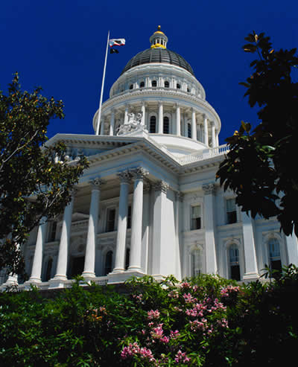
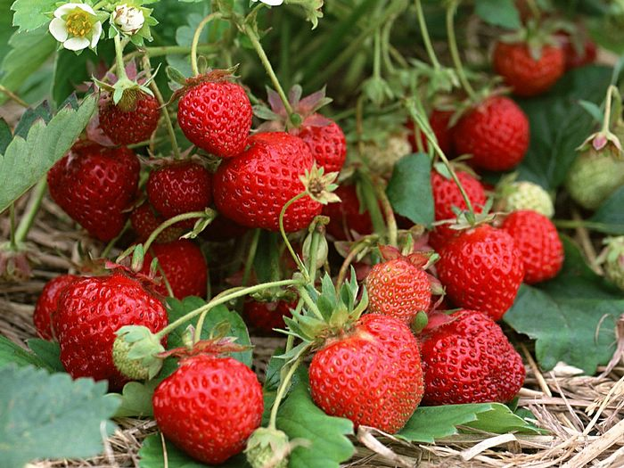
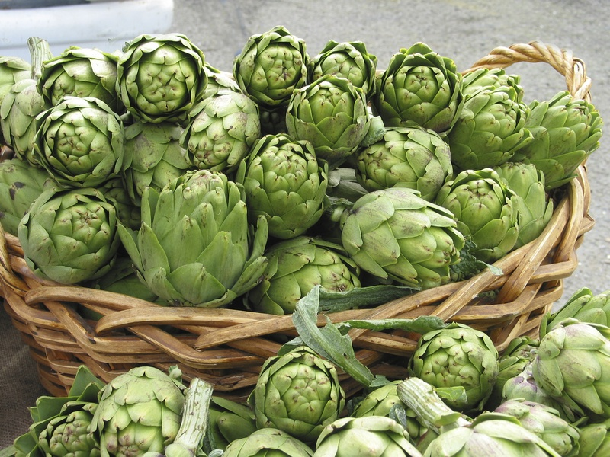
www.wallcoo.net/photography/fruit_strawberry
www.sacramento-directory.com
lebonnefleur.wordpress.com/2010/05/28/fleurty-fridays-artichoke/
Notes:
Certainly not our state’s capital. In fact, Sacramento is one of the richest agricultural cities in the nation, however, it has been identifies as a desert. This study explores how Sacramento County could be definition as a desert and how that may effect resident’s health (go to next slide).

Slide 3
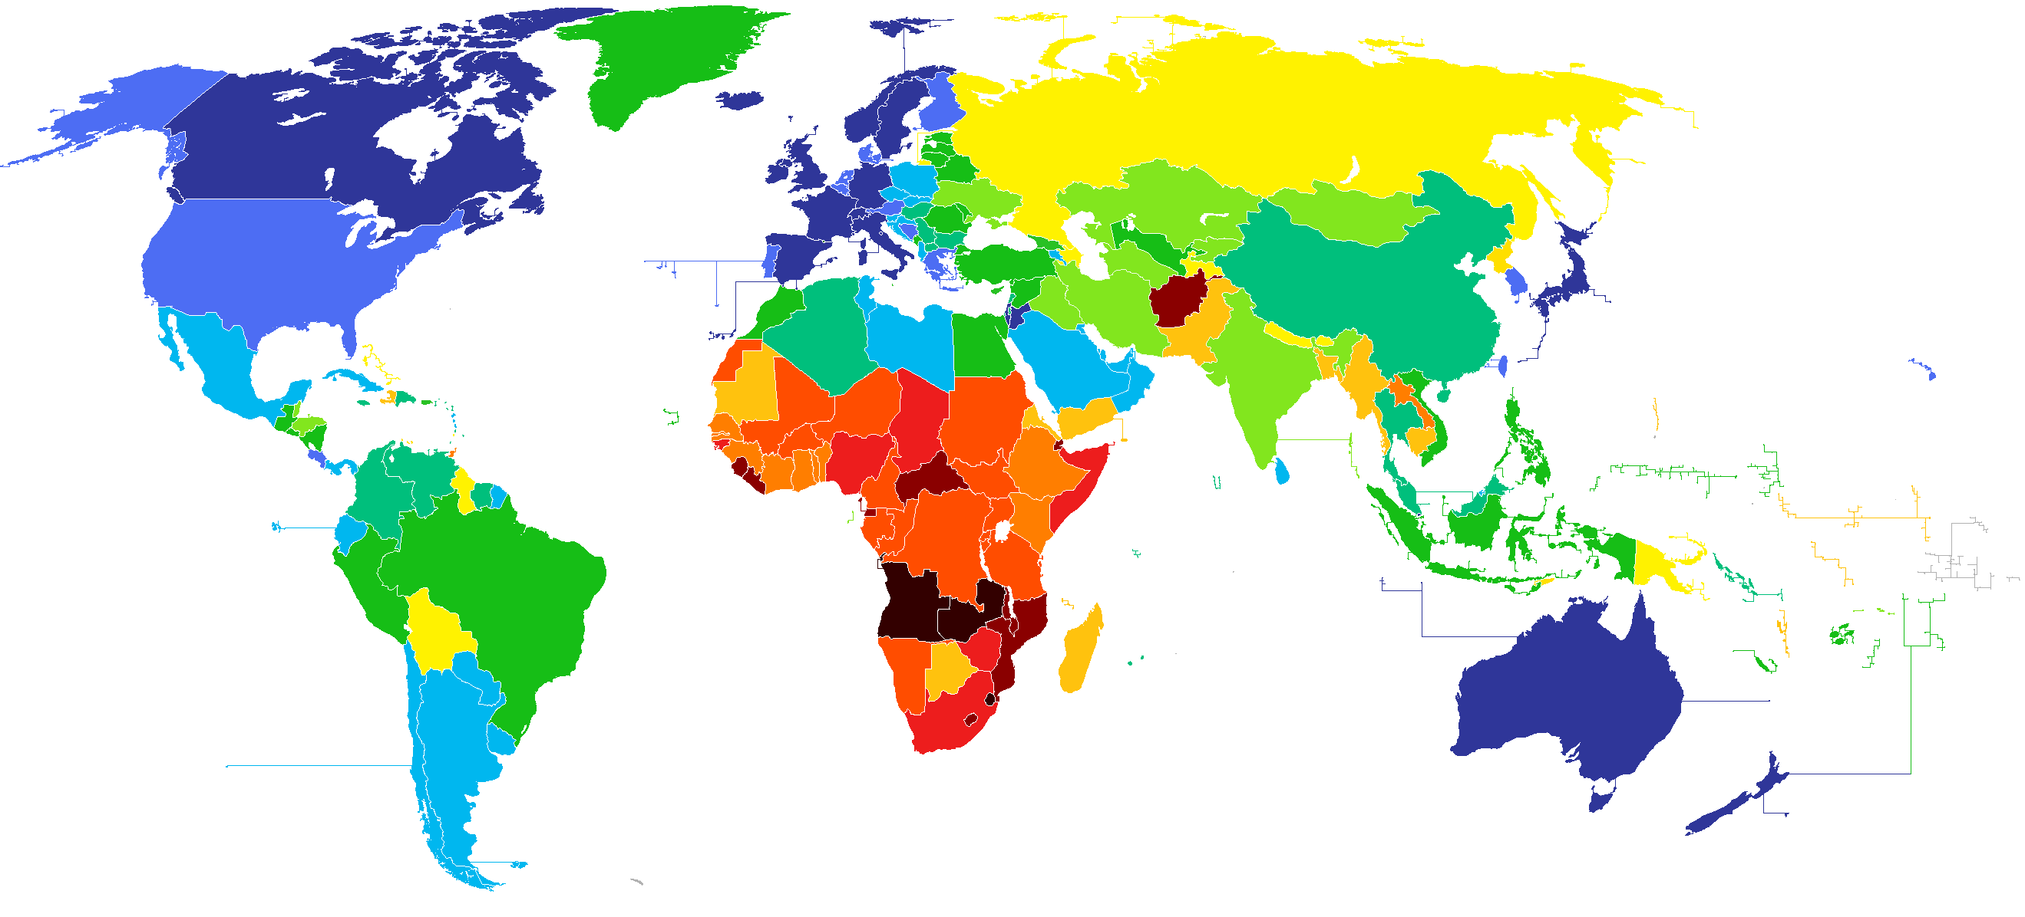
From Serengeti to Sacramento:
The Racial Disparity in the Distribution of Food Deserts
Jasmine Stewart-Oliver
Notes:
This study entitled ,“From the Serengeti to Sacramento: The Racial Disparity in the Distribution of Food Deserts”, does not chronicle a desert biome but rather a new kind of desert. Instead it expands on decades of research on inequalities in food distribution.

Slide 4
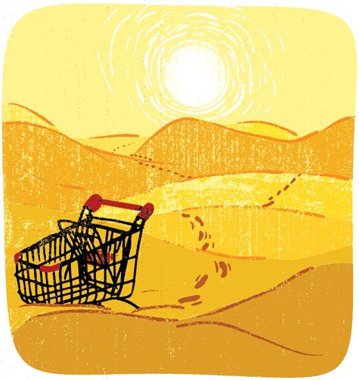
Previous Research New Focus
Previous
Starvation
Fragility
Children
Visible Problems
Current
Environmental
Longitudinal
Emotional
Educational
VS.
Notes:
Previous studies focused more on visibly controversial problems. Following to principles closer to the conflict theory. Highlighting problems such as starvation, visibly fragile and frail people, especially children.
Current studies on the inequalities in food distribution follow more of the systems theory, focusing on how each individual component of life effects the next. From this new focus came the term “food desert”.

Slide 5
Food Desert?

Slide 6
>10 %
5.1-10 %
2.5-5 %
< 2.5 %
No Data Available
Image: Crfoodchain.wordpress.com
Source: Department of Agriculture for Disease Control
Notes:
By definition a food deserts is a neighborhood where there are more residents living in that neighborhood who do not have access to large-scale grocery stores than those that do. That is the definition according to the Healthy Food Financing Initiative (HFFI).

Slide 7
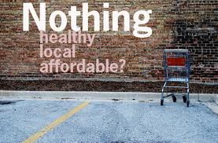
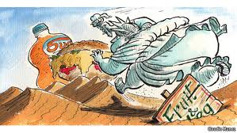
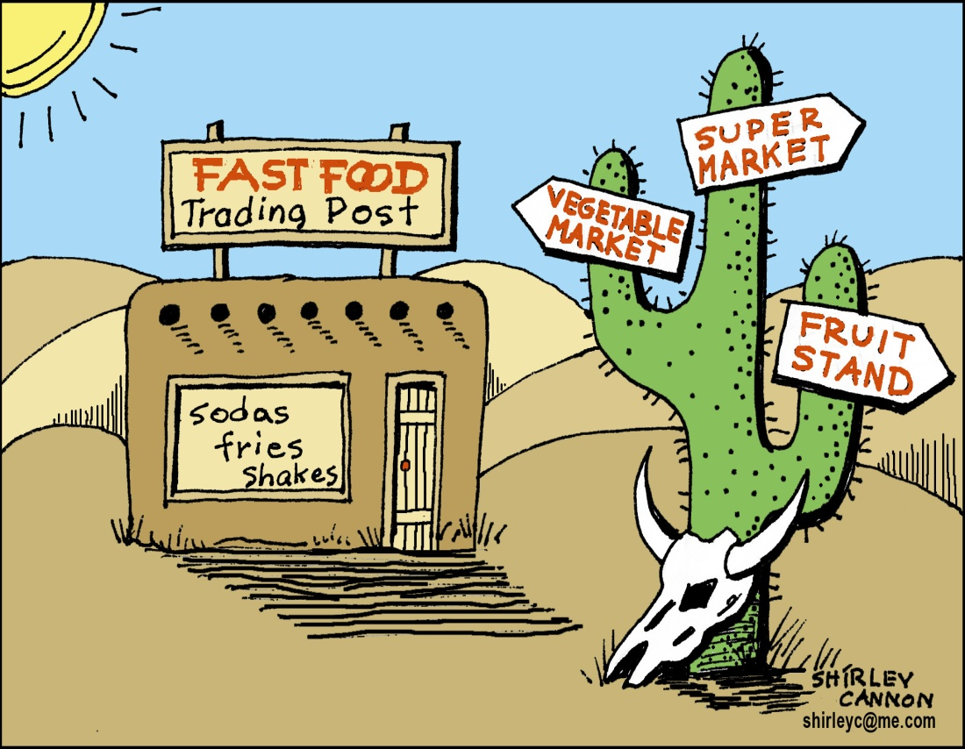
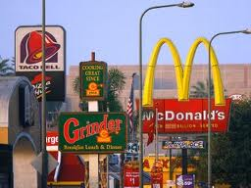
Economist.com
opinionator.blogs.nytimes.com
Keyconversationson.blogspot.com
jilgo.org
science.howstuffwork.com
Notes:
However in laymen’s term they are basically waste lands that have little to no access to fresh fruits and vegetables. They are neighborhoods that have more fast-food and convenience store options than health fresh food options. This is where this study takes to piton.

Slide 8
This study examines the racial composition between communities identified as food deserts and those that are not. Specifically, this study examines the composition of four racial groups in Sacramento County at the census tract level.
Notes:
In this study we expand on previous research food deserts by examining the quantitative racial data. What has been neglected in previous studies has been the racial composition of identified food deserts and links to health reports. This research takes one step into filling this void by examining the racial composition of food deserts in Sacramento County.

Slide 9
Hypothesis
A higher percentage of minority residents live in neighborhoods identified as food deserts compared to non-food desert neighborhoods.
Notes:
My hypothesis was that there would be more minorities living in areas identified as food deserts than in areas that were not.

Slide 10
Methodology
2010 Census Data
2010
USDA Data
Notes:
To test this hypothesis I merged data sets from the USDA data and the Census Bureau. The racial composition at the tract level was gathered from the 2010 Census report while the food deserts data for Sacramento County was gathered from the USDA.

Slide 11
Demographics of Independent Variable
White
Black
Asian
Hispanic
Notes:
For this study, race is the independent variable categorized as “White,” “Black,” “Asian” and “Hispanic.”

Slide 12
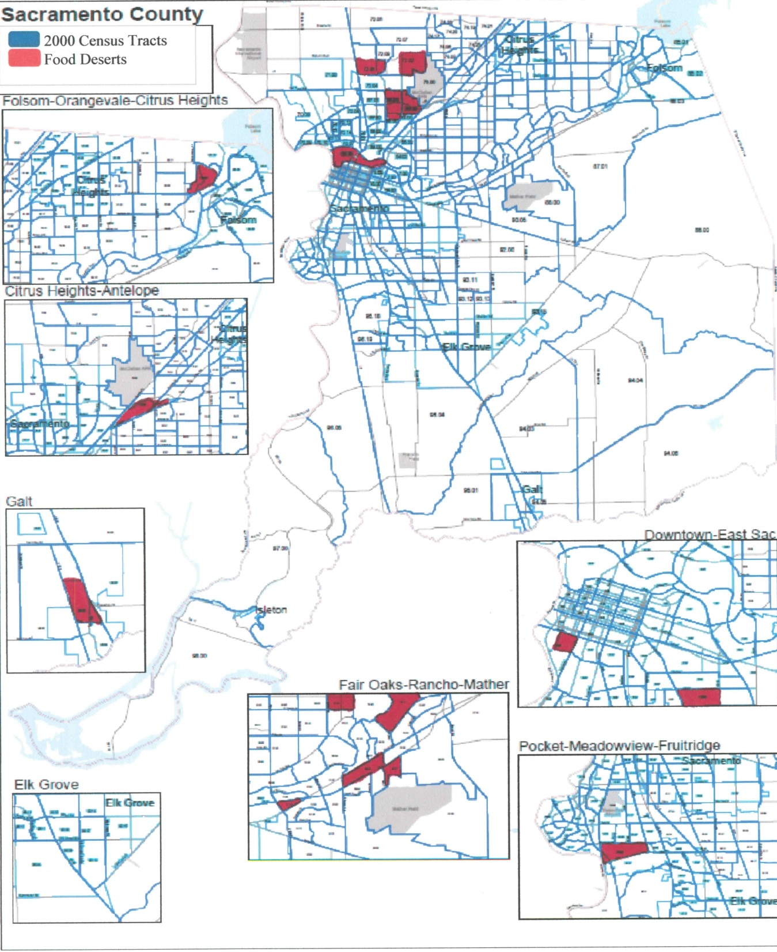
Independent Variable
35%

Slide 13
New Data Set
Census Tract
2010
USDA Food Desert
2010
Racial Composition of Food Deserts in Sacramento County

Slide 14
Food Desert
White
Black
Asian
Hispanic
Non- Food Desert
White
Black
Asian
Hispanic
Food Desert
White
Black
Asian
Hispanic

Slide 15
 | Food Deserts | Non-Food Deserts
 | N=23 | N=256 | Significance
Whites | 58% (+- 18) | 66% (+-19) | NO (Sig .551)
Blacks | 14% (+-11) | 8% ( +-7) | YES (Sig .03)
Asians | 9% (+-7) | 10% (+-9) | NO (Sig.117)
Hispanics | 18% (+-8) | 15% (+-9) | NO (Sig .987)
Total | 100% | 100%
Notes:
Once this information was compiled into SPSS, an independent samples t test to compare the means of the two groups. After running the independent samples t test I found that results do not completely support the proposed hypothesis. There was some relationship between racial composition and living in a food desert. With the exception of Hispanics. That group had no relationship present. However, if we look at “Blacks” we can see… (next slide)

Slide 16
 | Food Deserts | Non-Food Deserts
 | N=23 | N=256 | Significance
Whites | 58% (+- 18) | 66% (+-19) | NO (Sig .551)
Blacks | 14% (+-11) | 8% ( +-7) | YES (Sig .03)
Asians | 9% (+-7) | 10% (+-9) | NO (Sig.117)
Hispanics | 18% (+-8) | 15% (+-9) | NO (Sig .987)
Total | 100% | 100%
Notes:
The strongest relationship present was among this group. The highest percentages of minorities living in food deserts in Sacramento County were “Blacks”. This table highlights the percentage of “Blacks” who live in and those that do not live in food desert Census tracts in Sacramento County. “Blacks” had the strongest relationship (“sig” .003) between race and living in food deserts.

Slide 17
Societal Connotation
www.cdc.gov/diabetes/statistics/prev/national/figraceethsex.htm
Notes:
African Americans continuously are reported to be the unhealthiest of the American population. According to the CDC, in 2010, 4.9 million or 18.7% of this population had diabetes. Of the 25% of Americans that die annually from heart disease, the highest percentages (about 25%) are Black. This disproportionate percentage of Blacks suffering from food related disease is not only apparent in heart diseases. According to the National Center for Health Statistics, the prevalence of obesity is the highest among African Americans.

Slide 18
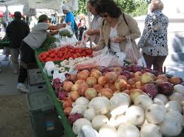
Prevention/Policy Recommendation
Notes:
Which leads to my conclusion, if large-scale grocery stores are reluctant to operating in stores lower income areas more focus should be given to alternatives options to bridge the gap between dietary needs and availability for those living in food deserts. Some feasible alternatives include the establishment of farmer’s markets, which promote the importance of fresh foods options and teach residents about self-sustaining agriculture. These efforts are effective in reducing the detrimental effect of food deserts in urban impoverished neighborhoods.

Slide 19
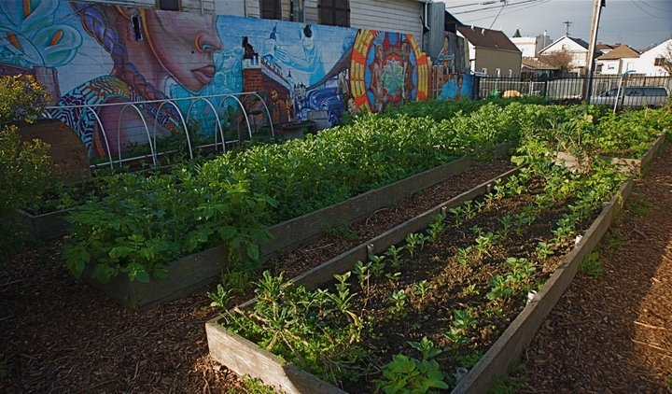
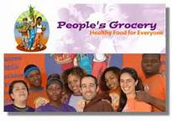
People’s Grocery West Oakland

